Slide 1

Project Proposal:- WeatherTech WorkForce Scheduling
Presented By: Amandeep,
Himani,
Arvind

Slide 2
Introduction to Workforce Scheduling at WeatherTech
Scheduling Dynamics: Emphasizes the complexity of scheduling in a setting with variable demands and a mix of full-time and part-time staff.
Operational Constraints: How introducing the various constraints that affect scheduling, from budget limitations to employee availability.
Project Focus: Analysis of Weathertech workforce scheduling (Fall/ Spring)
Importance: Underscoring the significance of effective scheduling in maintaining operational efficiency and meeting organizational goals.

Slide 3

Problem Statement
Operation: Open 7 days a week from 7 a.m. to 11 p.m. with varying daily demands.
Staff: Mix of full-time and part-time employees.
Requirements:
At least one full-time employee for closing.
Full-time: Minimum 40 hours/week.
Part-time (students): Flexible shifts based on class schedules. Minimum 10 hours/week and Maximum 20 hours/week
Hourly Pay:
Full-time: $20/hour.
Part-time: $16/hour.
Budget Constraint: Choices between reducing hours or staff layoffs.
Summer Operations: Only full-time staff due to student absence.
Solution: Use linear programming and Gurobi for workforce optimization.
Applicability: Extendable to other university shift-based employment scenarios.

Slide 4
Problem Statement
Operation: Open 7 days a week from 7 a.m. to 11 p.m. with varying daily demands.
Staff: Mix of full-time and part-time employees.
Requirements:
At least one full-time employee for closing.
Full-time: Minimum 40 hours/week.
Part-time (students): Flexible shifts based on class schedules. Minimum 10 hours/week and Maximum 20 hours/week
Hourly Pay:
Full-time: $20/hour.
Part-time: $16/hour.
Budget Constraint: Choices between reducing hours or staff layoffs.
Summer Operations: Only full-time staff due to student absence.
Solution: Use linear programming and Gurobi for workforce optimization.
Applicability: Extendable to other university shift-based employment scenarios.

Slide 5
LP Formulation

Slide 6
Decision Variables
Full-Time Employees’ Work Schedule
Variable: Xft,i,d,s
​Description: Binary variable (1 or 0).
Meaning:
1: Full-time employee i works on day d during shift s.
0: Employee does not work.
Part-Time Students’ Work Schedule
Variable: Xpt,j,d,s
Description: Binary variable (1 or 0).
Meaning:
1: Part-time student j works on day d during shift s.
0: Student does not work.

Slide 7
Objective Function
Our objective is to minimize costs by calculating the total wages for full-time and part-time staff.
This involves multiplying the number of shifts each employee works by their respective hourly wage and shift length.
Through this method, we aim to achieve a cost-effective balance between our budget constraints and staffing needs.
Minimize Total Cost:
Sum(Xft,i,d,s * fulltime_hourlywage * ShiftLength) +
Sum(​Xpt,j,d,s * parttime_hourlywage * ShiftLength)

Slide 8
Constraints
1. Staffing Requirements for Each Shift (Fall/Spring):
For each shift during the fall and spring seasons, we ensure staffing requirements are met by having at least the required number of full-time and part-time workers.
Sum (Xft,i,d,s) ≥ FT_requirement[d,s], Sum (Xpt,j,d,s) ≥ PT_requirement[d,s]
2. Minimum and Maximum Hours for Part-Time Students (Fall/Spring):
We maintain a balance in part-time staffing, ensuring that the total hours worked by part-time employees each day are between 10 and 20 hours.
10 ≤ Sum(Xpt,j,d,s * ShiftLength) ≤ 20
Notes:
Ensures that the café has the required number of full-time and part-time staff for each shift from Monday to Thursday and Friday to Sunday.

Slide 9
Constraints
3. Minimum Hours for Full-Time Employees:
We ensure full-time employees work a minimum of 40 hours per week
Sum(Xft,i,d,s * ShiftLength) ≥ 40
4. Day Off for Full-Time Employees:
The total number of days full-time employees work each week is limited to one less than the total number of working days.
Sum(Xft,i,d) ≤ Number of Working Days per Week−1
Notes:
Ensures that full-time employees work a minimum of 40 hours per week.

Slide 10
Gurobi Model

Slide 11
WeatherTech WorkForce Scheduling Data
Total Workforce Composition:
4 Full-Time Employees, 19 Part-Time Students
Full-Time Employees:
Shifts: Morning (7 am - 3 pm) and Evening (3 pm - 11 pm)
Staffing per Shift: 2 employees (Mon - Fri), 1 employee (Sat-Sun)
Part-Time Employees:
They have a flexible 4-hour shift blocks
Shift Timings: Ranging from Morning (7 am) to Late Night (11 pm)
Staffing per 4-Hour Block: 3 employees at every hour (Mon - Fri), 4 employees at every hour (Sat - Sun)

Slide 12
Code Snippets
Ensuring Full-Time Staffing Requirements:
Code Functionality: This constraints to ensure that the number of full-time employees scheduled for each shift matches the required staffing levels.
Loop Structure: Iterates over each day and shift combination.
Constraint Logic: The sum of full-time employees working (work_ft[i, day, shift]) on a particular day and shift must equal the predefined requirement (FT_REQ_FALL_SPRING[day][shift]).
Objective: This constraint guarantees that Weathertech Café is adequately staffed with full-time employees during all operating hours, ensuring consistent service quality and operational efficiency.
# Full-time staffing requirements
for day in DAYS:
for shift in FT_SHIFT_TIMES:
model.addConstr(sum(work_ft[i, day, shift] for i in range(FT_EMPLOYEES)) == FT_REQ_FALL_SPRING[day][shift],
f"ft_req_{day}_{shift}")

Slide 13
Code Snippets
4-Hour Block Staffing:
Assigns part-time staff to meet specific requirements for every 4-hour shift block.
Ensures the sum of part-time employees working in each block is at least the set minimum.
# Part-time staffing requirements for every 4-hour block
for day in DAYS:
for period in PT_SHIFT_PERIODS:
model.addConstr(
sum(work_pt[j, day, shift]
for j in range(PT_EMPLOYEES)
for shift in PT_SHIFT_TIMES
if period in shift_periods[shift]
)
>= PT_REQ_FALL_SPRING_NEW[day][period],
f"pt_coverage_{day}_{shift}"
)

Slide 14
Code Snippets
Preventing Overlap in Shifts:
Ensures part-time employees are not scheduled for overlapping shifts.
Applies a constraint that limits each part-time employee to one shift per time period.
# Prevent overlapping shifts for part-time employees using shift periods
for j in range(PT_EMPLOYEES):
for day in DAYS:
for period in PT_SHIFT_PERIODS:
model.addConstr(
sum(work_pt[j, day, shift]
for shift in PT_SHIFT_TIMES
if period in shift_periods[shift]
)
<=
1,
f"no_overlap_pt_{j}_{day}_{period}"
)

Slide 15
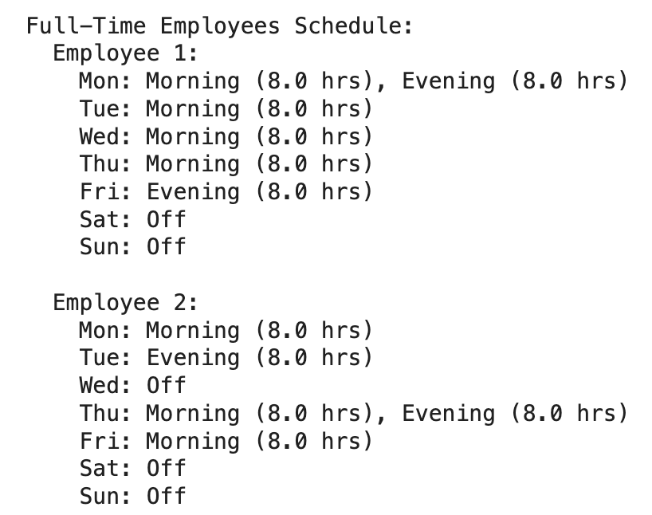
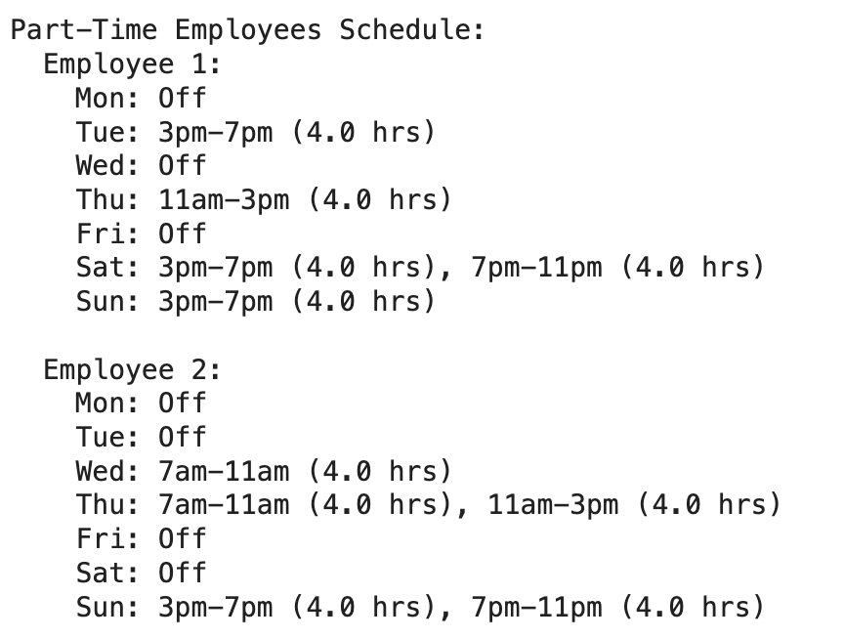
Output for the WorkForce Scheduling Model
Total Cost of Optimal Schedule: $9408.00
Total Cost for Full-Time Employees: $3520.00
Total Cost for Part-Time Employees: $5888.00

Slide 16
WorkForce Scheduling Challenges
Initial Challenge: Scheduling part-time employees without overlap; 4-hour shifts from 7 AM to 7 PM; additional staff required on weekends.
Infeasibility Issue: Initial model led to infeasible solutions, particularly for weekend staffing.
Solution Approach: Utilized Gurobi's model.computeIIS() to generate an ILP file, enabling detailed analysis of part-time constraints.
Key Discovery: Model allowed part-timers to work over 20 hours/day.
Resolution: Corrected the model with manual recalculations and guidance from a professor, ensuring compliance with daily and weekly work hour limits.
Outcome: Successfully implemented a feasible and efficient scheduling system for part-time employees.

Slide 17
Lessons Learned
Start with Linear Programming (LP) Formulation:
Gain insights into decision variables and constraints.
Facilitates smoother implementation in Gurobi.
Handling Infeasibility:
Learned strategies for diagnosing and resolving model infeasibility.
Data Accuracy:
Ensure up-to-date and reliable employee data.

Slide 18
Conclusion
Through our model, we have achieved approximately 9.3% cost savings for full-time employees (reduced from $3880 to $3520).
For part-time employees, despite a slight increase in costs from $5718 to $5888, our model successfully meets all requirements unlike current schedule.
We are refining our model to better accommodate part-time staff by ensuring that if they are scheduled for two shifts in a day, these shifts are consecutive, avoiding gaps of 4 or 8 hours for improved efficiency.

